Slide 1
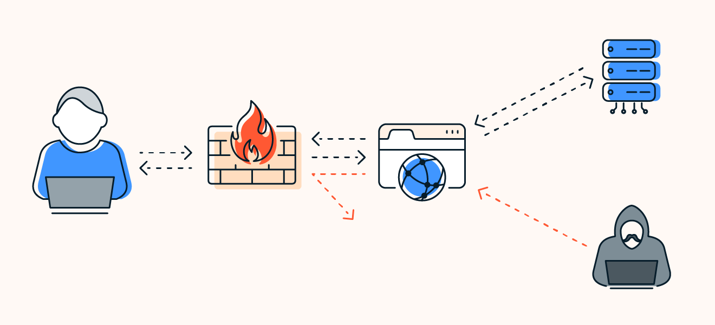
Introduction to ML-based Web Application Firewalls
Web application firewalls (WAFs) are essential for protecting web applications from malicious attacks. Machine learning (ML) is revolutionizing WAF technology, enabling more intelligent and adaptive security solutions.

Slide 2

Importance of Web Application Security
Web applications are critical for businesses, providing access to data, services, and online transactions. Securing these applications is paramount to protecting sensitive information, ensuring business continuity, and maintaining customer trust.
1
Data Breaches
2
Service Disruptions
3
Financial Losses
4
Reputation Damage

Slide 3
Traditional WAFs vs. ML-based Approach
Traditional WAFs rely on predefined rules and signatures to detect threats, making them susceptible to evolving attacks. ML-based WAFs leverage algorithms to learn from patterns and detect anomalies, providing more dynamic and adaptive security.
Traditional WAFs
ML-based WAFs
Rule-based approach
Adaptive learning
Signature matching
Anomaly detection
Limited adaptability
Enhanced accuracy
False positives
Reduced false positives

Slide 4
Raw Data Collection
Traffic Analysis
Analyze web traffic patterns, identifying deviations from normal behavior.
Data Preparation
Clustering Algorithms
User Behavior Profiling
Create profiles of typical user behavior to detect unusual actions or requests.
Manually proxy Setup
Threat Correlation
Correlate suspicious activities with known attack patterns and indicators of compromise.
Real-time Testing

Slide 5

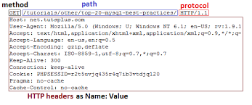
Raw Data Collection
Raw Data Collection
Data Preparation
BURPSUITE
Clustering Algorithms
Manually proxy Setup
Real-time Testing

Slide 6
Raw Data Collection
Data Preparation
Data Preparation
Feature Extraction
Clustering Algorithms
Methods | Path | Body | Single_q | Double_q | Dashes | Spaces
Post | /sign | ' or '1'='1'-- | 5 | 0 | 2 | 2
Manually proxy Setup
' or '1'='1'--
Real-time Testing

Slide 7
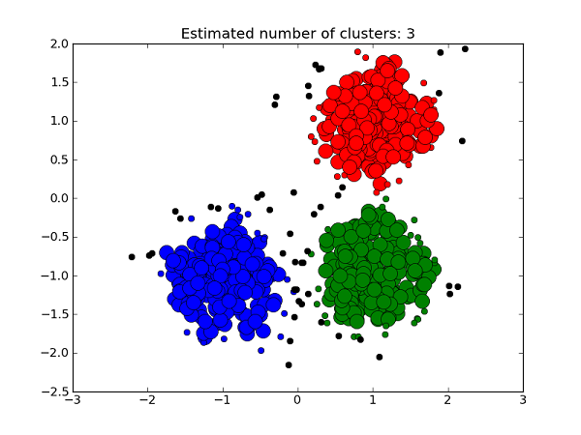
Raw Data Collection
Clustering Algorithms
Clustering algorithms are used to group data points based on certain similarities
Data Preparation
Clustering Algorithms
Manually proxy Setup
Real-time Testing
Why we are you using clustering ?

Slide 8
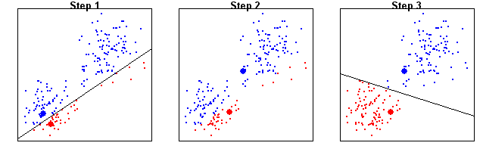
Raw Data Collection
K-Means Clustering
We try k Values. (k=2)
Initialize the ‘k’ number of centroids
Compute the Average
Update the Centroids.
Data Preparation
Clustering Algorithms
Manually proxy Setup
Real-time Testing

Slide 9
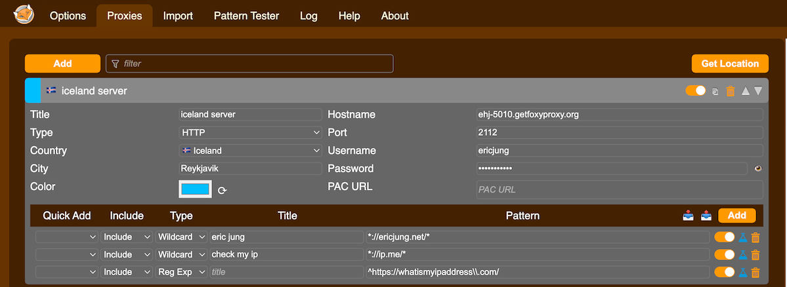



Raw Data Collection
Manually Proxy Setup
Data Preparation
Clustering Algorithms
Manually proxy Setup
Real-time Testing
Firefox
Foxy proxy
Server

Slide 10

Raw Data Collection
Real-time Testing
Data Preparation
Clustering Algorithms
Server
' or '1'='1'--
Manually proxy Setup
Firewall
Brower
Client
Real-time Testing
Hacker

